Slide 1
Valency of Verbs in Dependency Syntax
Prof. Vanessa Gorman
University of Nebraska-Lincoln
vgorman1@unl.edu

Slide 2
Terminology
Morphology = The system of different forms for a given word; specific identification of the inflection of a given word
Syntax = The arrangement of words to create well-formed sentences in a given language
Grammar = The study of the way the sentences of a language are constructed; morphology and syntax

Slide 3
Dependency Syntax
Dependency Trees
The verb is the structural center of any clause
Linguistic units (words) are connected by direct links and occur only once in the analysis of the structure of the sentence
Better for languages with free word order/periodic
English has fixed word order: SBJ – VERB - OBJ
Simple and straightforward; easy to learn
Contrast constituency syntax (Chomsky)
Linguistic units occur multiple times
Complex and hard to learn; Better for languages with fixed word order

Slide 4
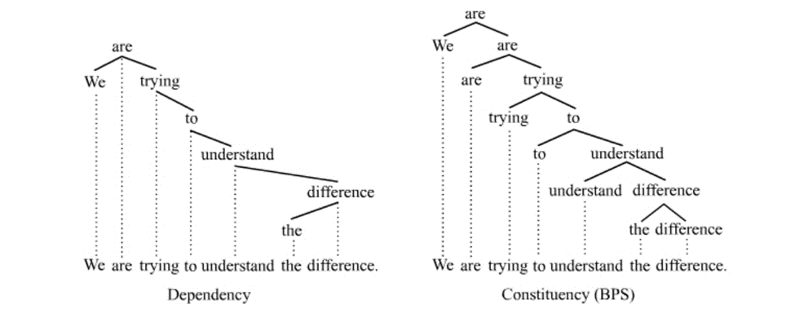
Dependency syntax versus constituency syntax

Slide 5
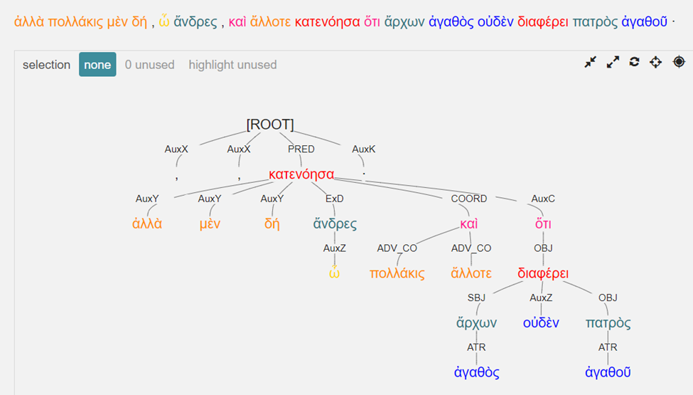
Dependency Syntax for Greek [Arethusa through the Perseids Project]
Xenophon, Cyropaedia 8.1.1

Slide 6
Types of Conjugated Verbs
Transitive verbs = the action is carried across to a receiver
I.e., there is a subject [SBJ] and object(s) [OBJ], whether expressed or implied.
“The Athenians [SBJ] fought a war [OBJ].”
“The war [SBJ] was won by them [OBJ].”
“Sosios [SBJ] obeyed.” [object is implied]
Intransitive verbs = the action stays with the verb
Subject, but no object.
“The army [SBJ] marched at dawn.”

Slide 7
Copular verbs
Link equivalencies [expressed in the same case]
Also called “linking” or copulative”
The constructions so linked are labelled Subject [SBJ] and Predicate Nominative [PNOM] in dependency syntax.
“to be” or “to become”
“Tissaphernes [SBJ] became satrap [PNOM].”
“The agora [SBJ] was full of people [PNOM].”
Other verbs function in the same way
“Cimon [SBJ] felt ill [PNOM].”
“Alcibiades [SBJ] was found guilty [PNOM].”
“The Milesians [SBJ] remained courageous [PNOM].”

Slide 8
“Valency”
Describes the number of arguments a particular verb requires in dependency syntax.
Usually labelled SBJ, OBJ, PNOM
The arguments are sometimes assumed rather than expressed
Every element not required by the valency of the verb is called a satellite or an adjunct.
Usually labelled as “Adverbial” [ADV]
Voice expresses the relationship between the action of the verb and its arguments

Slide 9
Arguments of a verb
Zerovalent verbs do not require any argument to complete their meaning.
“It rains.” [“It” doesn’t mean anything]
Rare
Monovalent verbs require one argument
Intransitive verbs: “Let the games begin,” or “The chariot crashed.”

Slide 10
Bivalent verbs
Require two arguments
The argument that performs the action (an agent)
A second element upon which the action is performed
•Active verbs
“Themistocles [SBJ] made ships [OBJ].”
Themistocles cannot “make” without there is an OBJ for that making.
Passive verbs
“The war [SBJ] was begun by Xerxes [OBJ].”
The agent and the element upon which he is acting.
Sometimes impersonal verbs fit this category.
“It is better for Cimon to leave.”
“To leave [SBJ] is better [PNOM] for Cimon [OBJ].”
“For Cimon [SBJ of inf] to leave [SBJ] is better [PNOM] [Assumed ‘for us’] [OBJ].”

Slide 11
Trivalent verbs
“The Athenians sent Sparta reinforcements” has three arguments.
In English we often call them the “subject,” “indirect object,” and “direct object.”
Just OBJ in Greek
Can be expressed with prepositions
“The Athenians [SBJ] sent [PNOM] reinforcements [OBJ] to Sparta [OBJ].”
“Pompey [SBJ] fought [PNOM] a war [OBJ] against Mithridates [OBJ].”

Slide 12
Miscellaneous Notes
The same verb may require a different number of arguments depending on how it is being used in a particular context.
“Mary runs every day” is monovalent: only the subject is a necessary element.
“Mary runs a marathon once a month” is bivalent.
Sometimes an argument is not directly stated, but it is still implied and is still considered an argument, if you must assume it from the context.
“Max gives to charities” implies a direct object “money.”
Much dispute as to whether verbs can have four arguments.
“Darius appointed Tissaphernes as satrap for the Ionians.”
OCOMP [object complement]

Slide 13
Impersonal Verbs
Verbs in the third person singular that have no subject in a normal sense
It is useful, it is clear, it is important, etc.
Zerovalent: “It rains.”
Monovalent: “It is necessary to breathe [SBJ].”
Bivalent: “It is necessary for them [OBJ] to eat [SBJ] before they leave”
“To eat is necessary for them.”

Slide 14
What is the morphology and valency of these verbs? [Xen., Hell. 1.1.5]
And the Athenians attacked him and did battle, along the strand near Abydus, from morning till late afternoon. At some points, they were victorious and at others they were defeated, when Alcibiades sailed into the Hellespont to their support with eighteen ships.
Attacked
= 3rd pl aor ind act
Bivalent
Did battle
= 3rd pl aor ind act
Bivalent
Were victorious; were defeated
3rd pl impf ind act
Monovalent
Sailed
= 3rd sg aor ind act
Monovalent

Slide 15
What is the morphology and valency of these verbs? [Xen., Hell. 1.1.5]
Those who hd associated with Hermocrates felt exceedingly the loss of his care and enthusiasm and democratic spirit. For he used to gather them every day in the morning and at evening to his own tent, where he communicated to them whatever he was planning to say or to do.
Felt
= 3rd pl aor ind act
Bivalent
Used to gather
= 3rd sg impf ind act [habitual]
Bivalent
Communicated
3rd sg impf ind act
Trivalent

Slide 16
What is the Valency of these Verbs?
After this happened, Tissaphernes came to the Hellespont. When Alcibiades with [a] single trireme went to visit him, bearing friendly offerings and gifts, Tissaphernes seized him and imprisoned him in Sardis, saying that the King ordered him to make war upon the Athenians. Thirty days later, however, Alcibiades and Mantitheus, who had been taken prisoner in Caria, provided themselves with horses and made their escape from Sardis by night to Clazomenae.

Slide 17
What is the morphology and valency of these verbs?
After this happened, Tissaphernes came to the Hellespont. When Alcibiades with [a] single trireme went to visit him, bearing friendly offerings and gifts, Tissaphernes seized him and imprisoned him in Sardis, saying that the King ordered him to make war upon the Athenians. Thirty days later, however, Alcibiades and Mantitheus, who had been taken prisoner in Caria, provided themselves with horses and made their escape from Sardis by night to Clazomenae.
Happened
= 3rd sg aor ind act
= monovalent =
SBJ
Came
3rd sg aor ind act
= bivalent = SBJ and place to which [OBJ]
Went
3rd sg aor ind act
= bivalent = SBJ and place to which OBJ [implied]
“To visit” is ADV expressing purpose
Seized and imprisoned
3rd sg aor ind act
= bivalent = SBJ and direct OBJ

Slide 18
What is the morphology and valency of these verbs?
After this happened, Tissaphernes came to the Hellespont. When Alcibiades with [a] single trireme went to visit him, bearing friendly offerings and gifts, Tissaphernes seized him and imprisoned him in Sardis, saying that the King ordered him to make war upon the Athenians. Thirty days later, however, Alcibiades and Mantitheus, who had been taken prisoner in Caria, provided themselves with horses and made their escape from Sardis by night to Clazomenae.
Ordered 3rd sg aor ind act
= trivalent
SBJ orders someone [OBJ] to do something [OBJ]
Provided
3rd pl aor ind act
= trivalent = SBJ provided something [OBJ] to someone [OBJ]
Made
3rd pl aor ind act
= bivalent = SBJ did something [OBJ]
Had been taken = mono or bi?
Is there an assumed agent?

Slide 19
A terrific reference work for dependency syntax in the context of the ancient world, albeit as applied to Latin, is Harm Pinkster’s new Oxford Latin Syntax. Volume 1, The Simple Clause, was published in 2015. Volume 2 is still forthcoming.

